Slide 1
History of Sabermetrics
BIG Problems

Slide 2

Henry Chadwick develops the box score
Bill James begins publishing
Bill James hired by Red Sox (who win 2004 World Series)
1858
1964
1977
2002
2003
2008
Earnshaw Cook releases Percentage Baseball
Oakland A’s win 20 games in a row under Billy Beane’s management
Nate Silver starts FiveThirtyEight.com
Notes:
Julia - add title

Slide 3
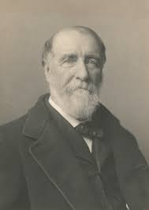
Timeline
1858
Henry Chadwick develops box score
Summarized individual and team performances through various statistics
1964
Earnshaw Cook releases Percentage Baseball
Criticized by both Baseball Executives and statisticians

Slide 4
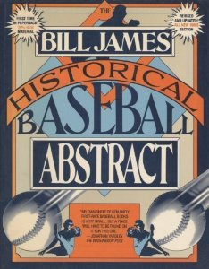
1977
Bill James publishes his first Baseball Abstract
“Featuring 18 categories of baseball statistics you just can’t find anywhere else
In depth statistics from James’ study of box scores
Rare example of statistics books reaching a mass audience
Officially coins term Sabermetrics
Society for American Baseball Research

Slide 5

2002
Oakland A’s GM Billy Beane and his assistant Paul DePodesta utilize a quantitative approach to baseball to help the A’s compete with larger market teams
2003
Bill James hired by Red Sox
Sabermetric techniques help Red Sox win World Series in 2004
2008
Nate Silver starts FiveThirtyEight.com, helping make statistical insight more accessible to the public
FiveThirtyEight.com acquired by ESPN in 2013

Slide 6
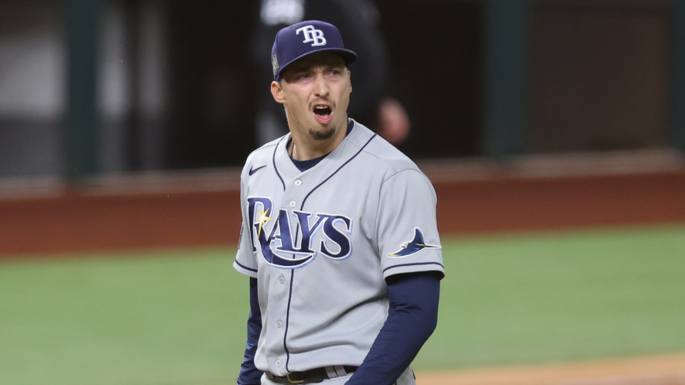
Success/Failure of Sabermetrics
Successes
2002 Oakland A’s
Same-handedness pitchers vs. hitters
Catchers’ framing
Strike rate
Runs from Extra Strikes
Failures
Simpler statistics don’t tell the whole story
Unweighted batting average
Baseball traditionalists argue against analytics
Ex: Pulling Blake Snell in the 2020 World Series

Slide 7
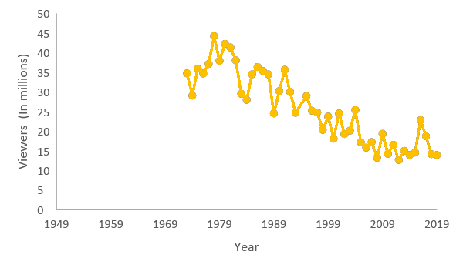
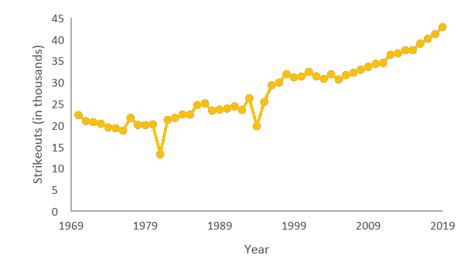


Cultural Pushback
Proliferation of Analytics
World Series TV Ratings by Year
Over the last decade analytics has proliferated throughout Major League Baseball
Offensively, the focus is to get hitters on base and to avoid higher risk plays such as stolen bases and bunts
This new style of baseball emphasizing home runs and strikeouts has coincided with a fall in MLB ratings
“I try to watch a baseball game, and I find it very difficult to be able to watch today” – Hall of Fame reliever Goose Gossage
.248 MLB batting average in 2019 was the lowest since 1972
In April of 2019 there were more strikeouts than hits for the first time in MLB history
Strikeouts in MLB by Year

Slide 8


Cascading Effect on Other Sports
Basketball
On-court efficiency of players and teams
Per-minute measurement ensures individual contributions are measured irrespective of usage volume.
Offensive & defensive efficiency, effective technical shooting percentage, etc.
Football
Football Outsiders
DVOA: defensive-adjusted value over average
Speed Score: adjusted 40-yard dash time
Ice hockey
Corsi
Fenwick
Notes:
Bill James’s philosophy was adapted to create weighted statistics that measure each player and each team's on-court efficiency
Began measuring on a per-minute basis in order to perform less biased analysis.
Efficiency ratings are essentially a weighted points scored or allowed per possession, with possessions being adjusted to account for rebounds and free throws
Football outsiders revolutionized advanced american football metrics in 2003
DVOA: accounts for down, distance, location on field, current score gap, quarter, and strength of opponent to account for individual success on a given play
Speed score: adjusts 40 times to account for strength and weight of running backs
Advanced metrics are becoming more and more common in NFL media, but we’re not seeing a Moneyball-like revolution in player evaluation
In the NHL, there’s a big emphasis on shot attempts and Corsi and Fenwick and different ways of measuring shot attempts which take away the “luck” that comes with the goal statistic in hockey

Slide 9
Popular Stats in Media
Wins Above Replacement (WAR)
If a player got injured and their team had to replace them with a freely available minor leaguer, how much value would the team be losing?
Context, league, and park-neutral; can compare between years, leagues, and teams
On-Base Plus Slugging (OPS)
On-base percentage + Slugging percentage
Combine how well a hitter can reach base, with how well he can hit for average and for power
Treats OBP as equal in value with SLG, while OBP is ~1.8x as important as SLG in terms of its effect on run scoring
Fielding Independent Pitching (FIP)
Estimates pitcher’s run prevention independent of performance of their defense
Strips out the role of defense, luck, and sequencing
Notes:
SLG in math terms, explain 1.8 (linear regression, mathletics)

Slide 10
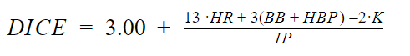
Flaws in Traditional Analytics
Pitching Measurements
ERA is used to measure pitching performance
Unfortunately ERA is not independent on the performance of outfielders
Errors by outfielders
Steals by runners
Defense Independent Measurements
Walks plus hits per innings pitched (WHIP): Daniel Okrent
One of the earliest developed Independent Measurements
Defense Independent ERA: Clay Dreslough

